Slide 1
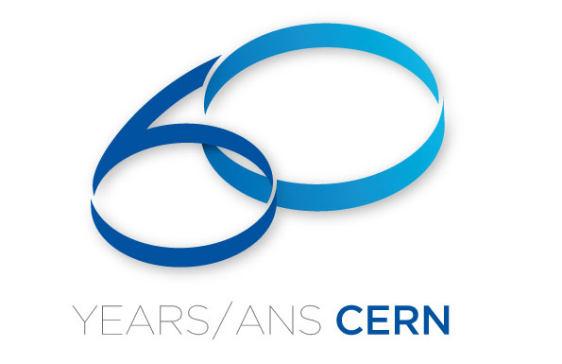

Slide 2






















Celebrating 60 years of Science for Peace
CERN, the European Organization for Nuclear Research, is celebrating its 60th birthday on September 29th.
The key messages engulfing all the celebrations are
60 years of Science for Peace
Scientific Discoveries and the way ahead
International Cooperation – Science as a motor for international dialogue
60 years of progress in Science and Technology
Science Education and Training – Modern Science for Everyone
The celebrations happen at the site of the Organization in Meyrin in the Canton of Geneva and in all of the now 21 members states.

Slide 3
Relevant Anniversaries in 2014/15
CERN-related Events | 25 y | The World Wide Web
 | 30 y | Nobel Prize for Rubbia and Van der Meer
 | 50 y | ESRO – European Space Research Organisation
 |  | ICTP – The Abdus Salam International Centre for Theoretical Physics
Other Anniversaries for Information | 40 y | J/ψ Discovery
 | 50 y | Initial publications on spontaneous symmetry breaking
 |  | Initial publications about quarks by Gell‐Mann and Zweig
 | 135 y | Albert Einstein
 | 200 y | The Swiss Academy of Sciences
 | 450 y | Galileo Galilei

Slide 4
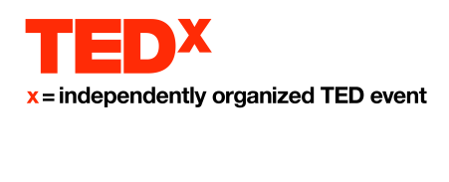
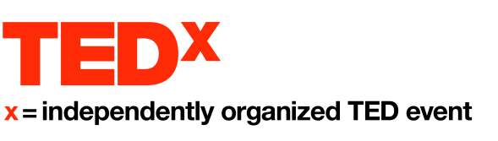



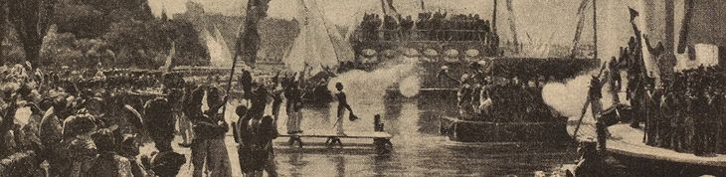

Several events will take place centrally
  July 1st, UNESCO, Paris
  Celebration of the Convention
  September 19th, CERN, Geneva
  Celebration of the First Council Session Anniversary
  September 29th, CERN, Geneva
  Celebration of CERN’s Anniversary
Many other events will happen during the year, e.g.

Slide 5
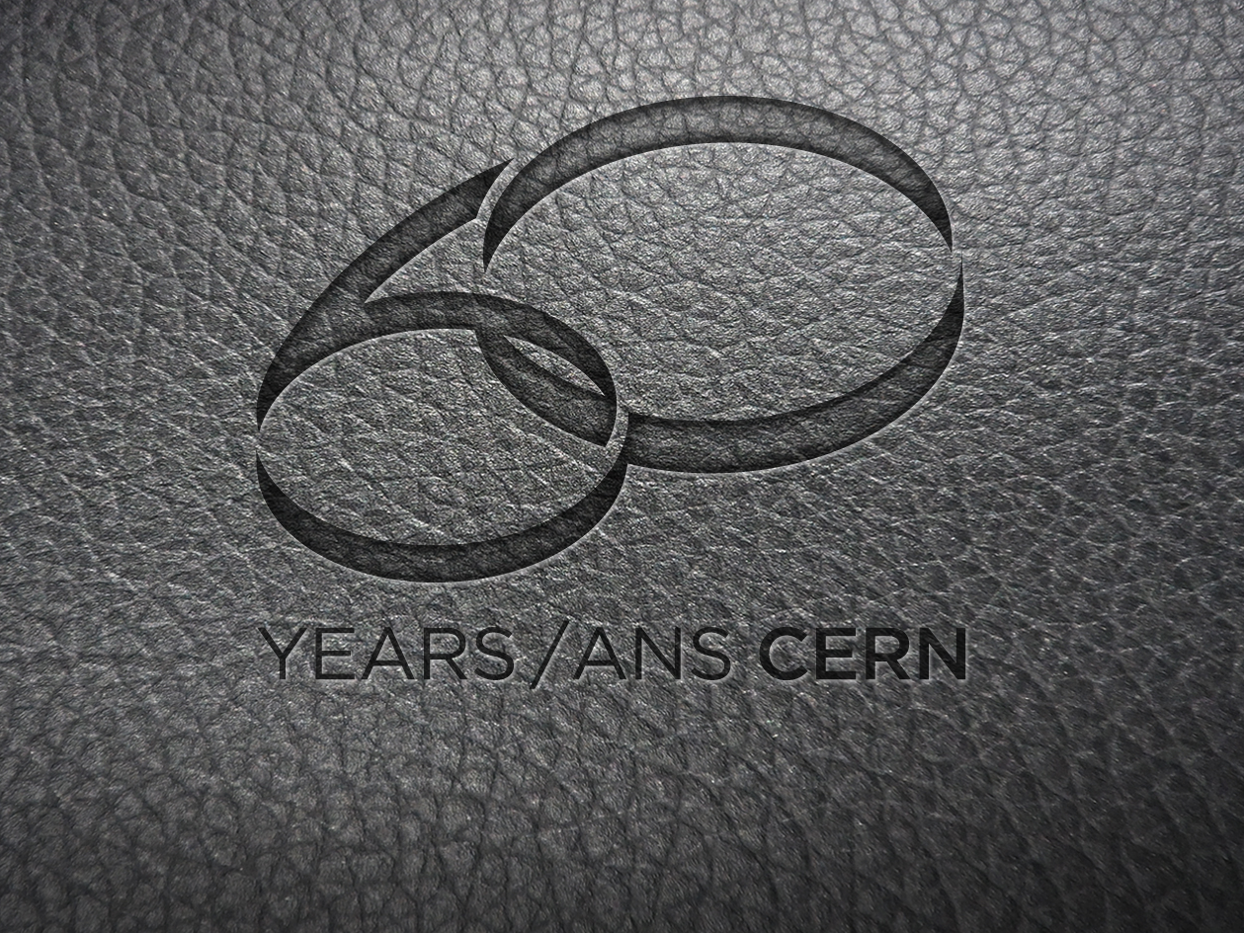
Stay tuned …
cern.ch/cern60
CERN60-Team@CERN.CH
 +41 22 767 6060
 +41 22 766 6060

